Slide 1




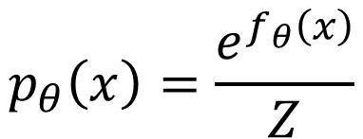
…
$$f_{θ}\left(x\right)$$
$$e^{f_{θ}\left(x\right)}$$
$$p_{θ}\left(x\right)=\frac{e^{f_{θ}\left(x\right)}}{Z}$$
…
positive
normalize
$$x$$
Generative Model

Slide 2
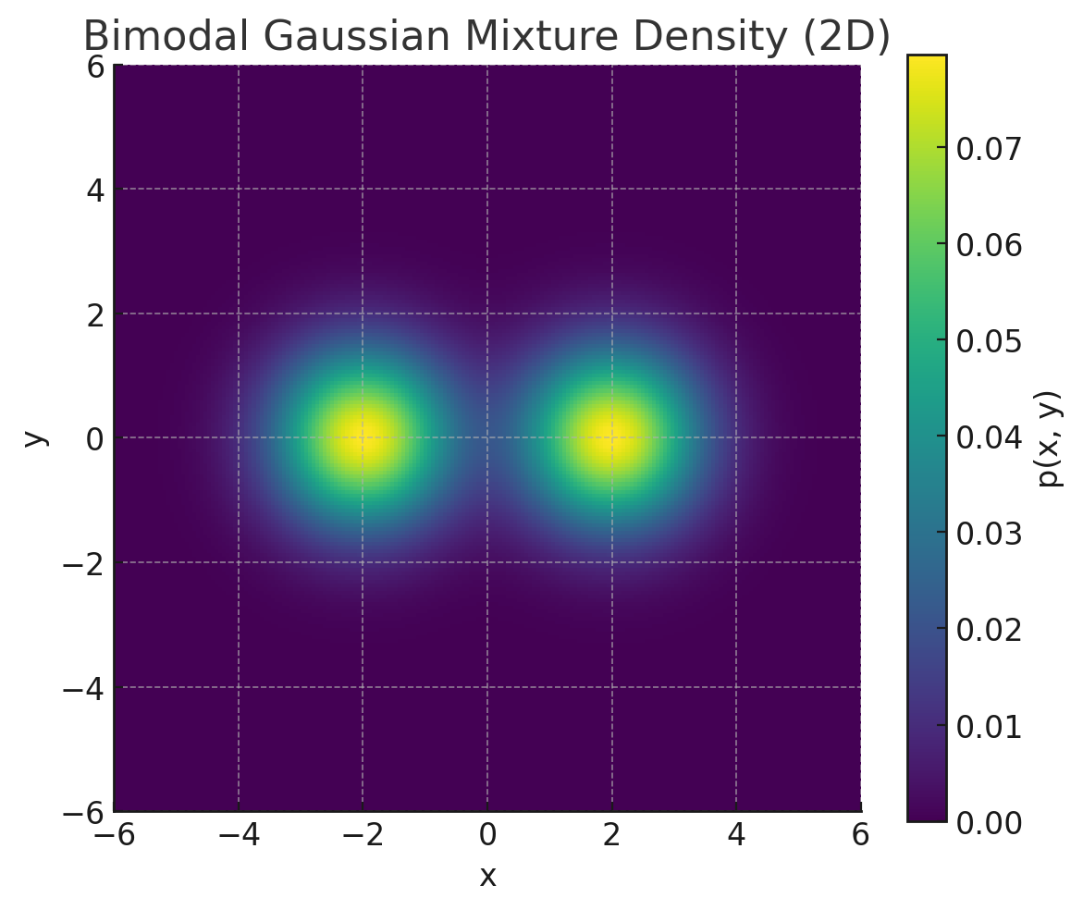
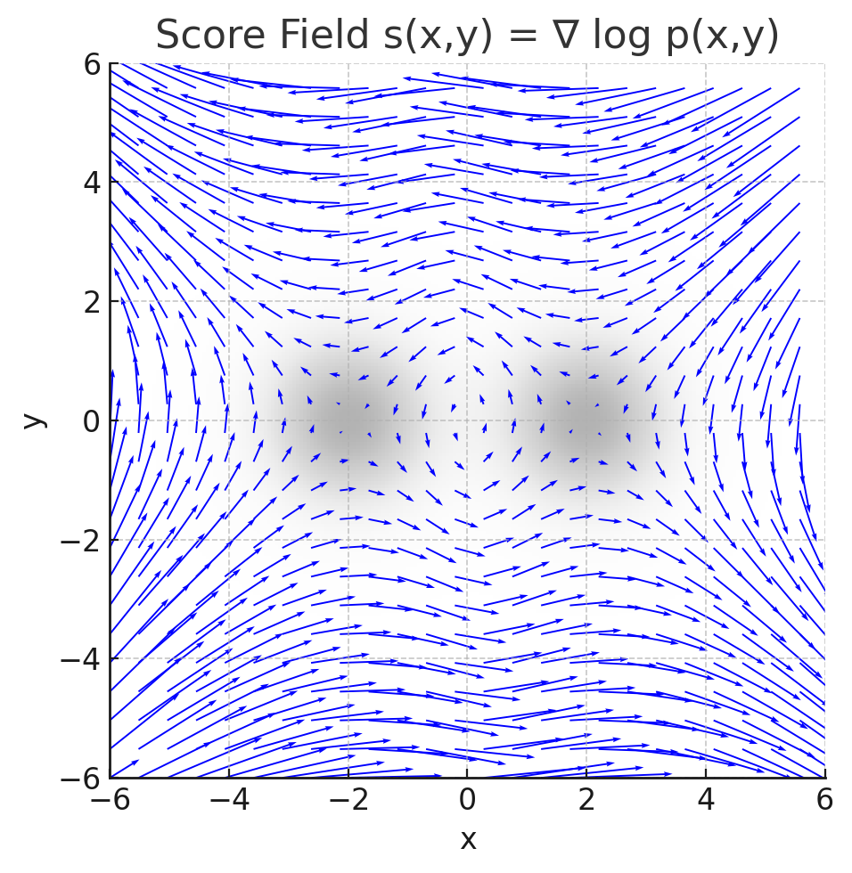
Probability Density
Score Function

Slide 3
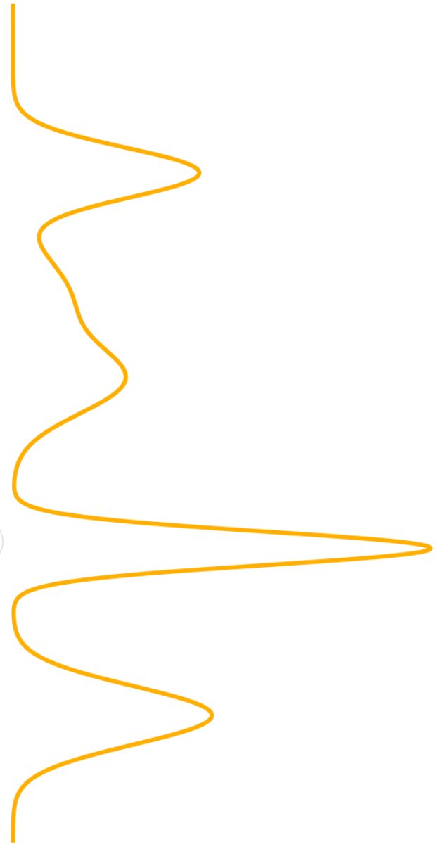
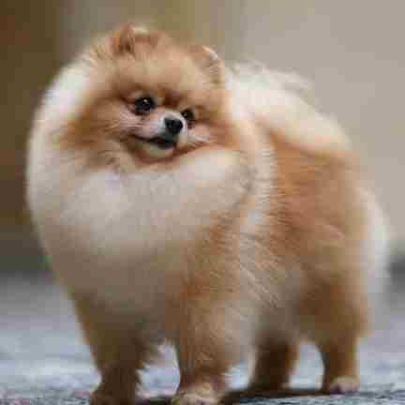
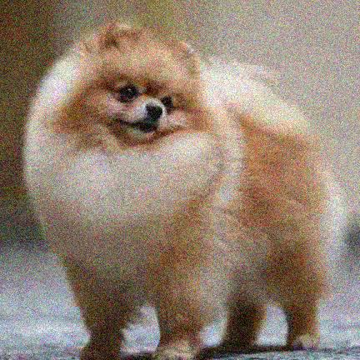

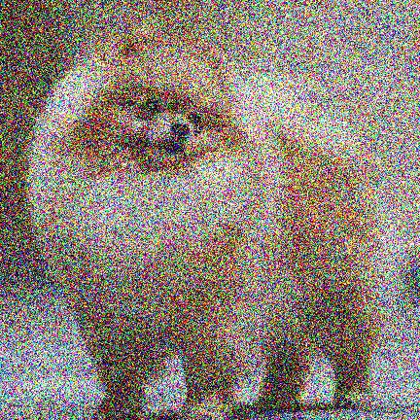
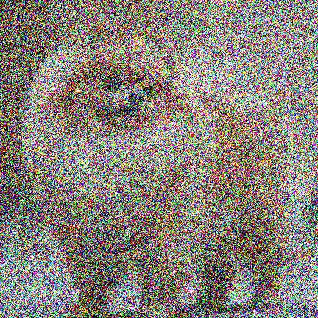
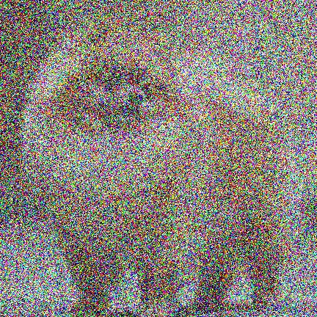


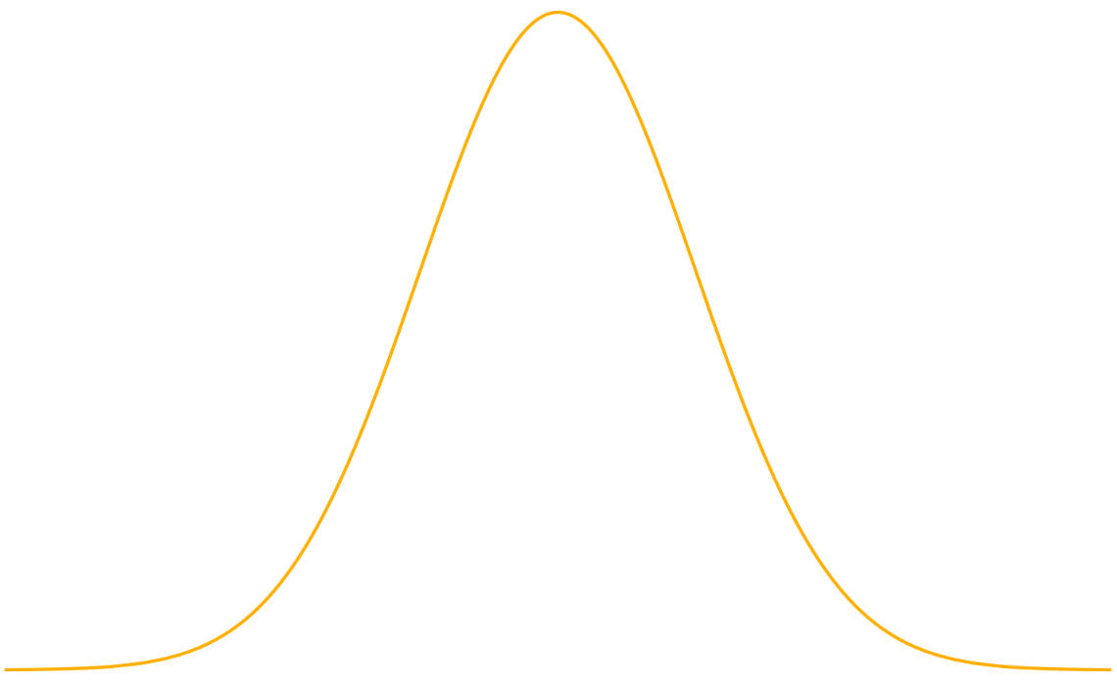












$$p_{data}$$
$$p_{init}$$
PF-ODE
$$f_{θ}\left(x_{t_{4}}, t_{4}\right)$$
$$t_{4}$$
$$t_{3}$$
$$t_{2}$$
$$t_{1}$$
$$t=0$$
$$t=T$$
$$f_{θ}\left(x_{t_{3}}, t_{3}\right)$$
$$f_{θ}\left(x_{t_{2}}, t_{2}\right)$$
$$f_{θ}\left(x_{t_{1}}, t_{1}\right)$$

Slide 4











$$x_{0} \sim p_{data}$$
Adversarial Loss
Forward Diffusion Process
Real / Fake
$$G_{φ}$$
$$φ$$
$$x_{s}=α\left(s\right)x_{0}+σ(s)ε$$
Student Model
$$x_{0}^{s}$$
Distillation Loss
Forward Diffusion Process
$$d\left(x_{0}^{s},x_{0}^{T} \right)$$
$$Φ_{ψ}$$
$$ψ$$
$$x_{t}=α\left(t\right)x_{0}+σ(t)ε$$
Teacher Model
$$x_{0}^{T}$$

